Slide 1
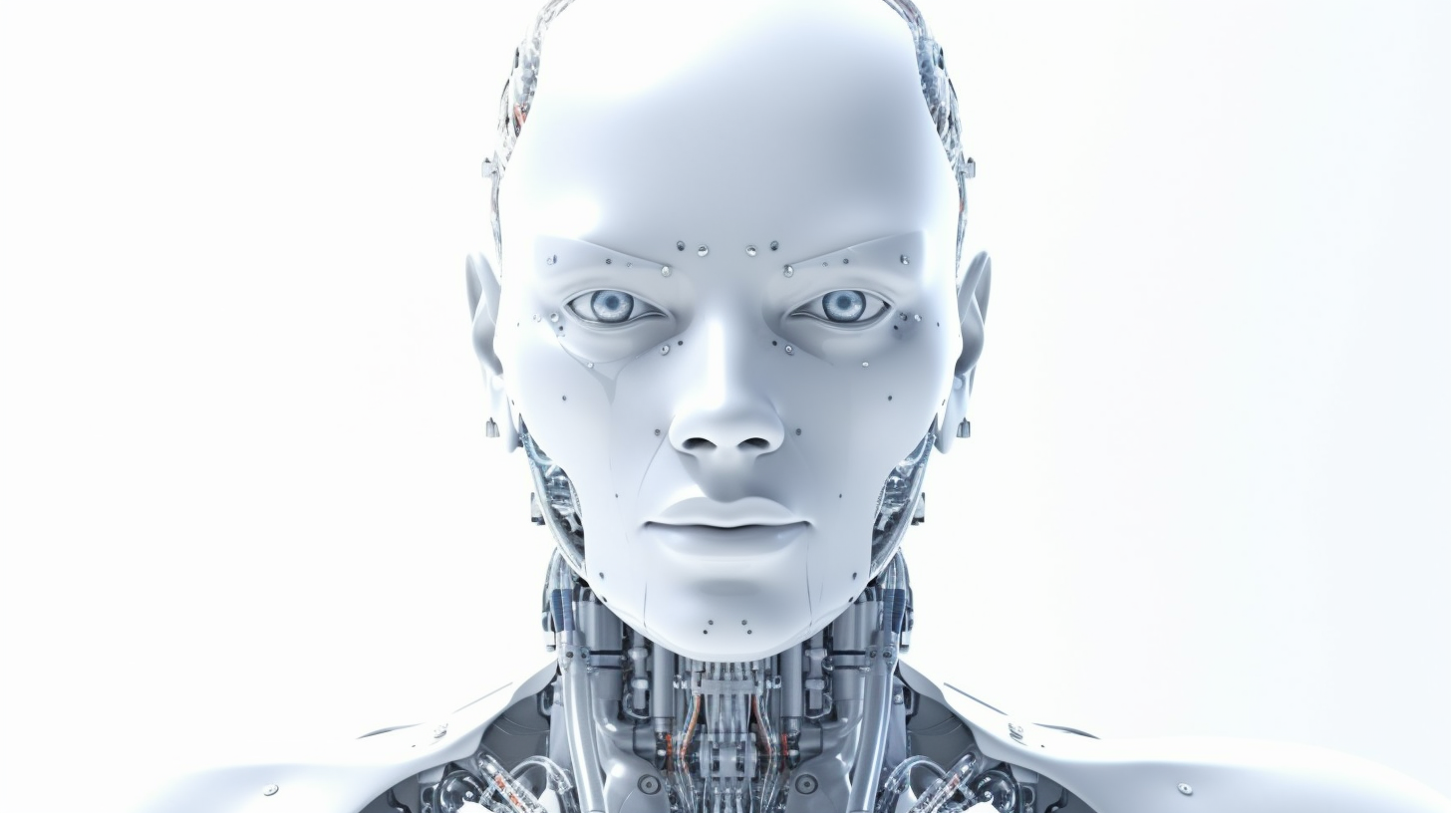
Privacy
Paradox

Slide 2



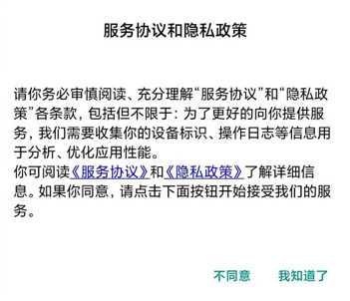
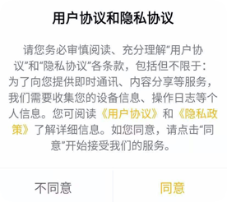
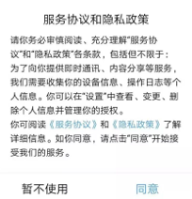
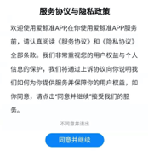

People are trapped in the Privacy Paradox
How do they
know what I want ?!
✔️
Fine, whatever

Slide 3

People are trapped in the Privacy Paradox
Privacy
Convenience

Slide 4
Von Neumann expected utility function
Value Function
Risk-aversion
Gain/Loss
Risk-loving

Slide 5
Von Neumann expected utility function
Value Function
Risk-aversion
Gain/Loss
Risk-loving

Slide 6

Von Neumann expected utility function
Keep privacy a secret to gain one more unit of profit
Share the information and bear one more unit of loss

Slide 7


BINARY EMOTIONS IN THE PRIVACY PARADOX
Burnout
Worry

Slide 8
BINARY EMOTIONS IN THE PRIVACY PARADOX
Risk-loving

Slide 9

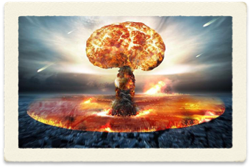
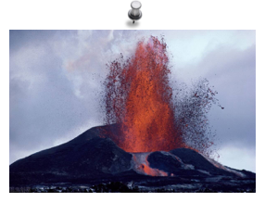
BINARY EMOTIONS IN THE PRIVACY PARADOX
No!!

Slide 10

Practical applications
The Anchoring Effect

Slide 11
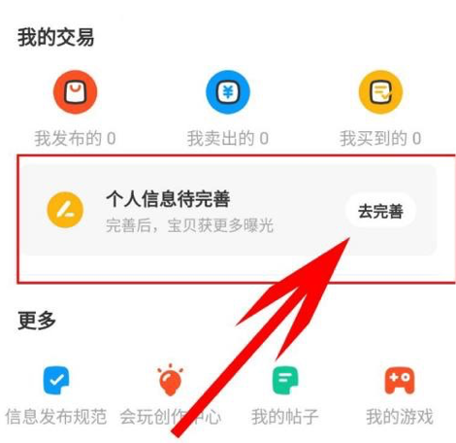
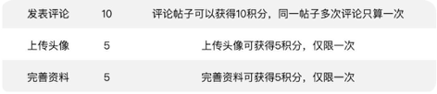
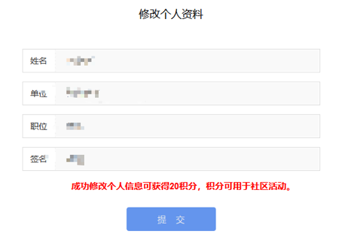
Practical applications
Welfare Compensation

Slide 12
Conclusion
Respect:
Manners Make the Man

